Slide 1
SAP BTP Architect Training
Day 3
Anubhav Oberoy
www.AnubhavTrainings.com
Follow excellence with sheer passion

Slide 2


DISCLAIMER
The training content and delivery of this presentation is confidential, and cannot be recorded, or copied and distributed to any third party, without the written consent of Anubhav Trainings

Slide 3
Agenda – Day 3
01
04
Understanding Application Security
Create First Node based Microservice
02
05
Working with App Router Module
Working with XSUAA
03
06
Introduction to JS and Node JS
Challenges in BTP application development

Slide 4
Authentication v/s Authorization
Authentication – It ensures that is our user a valid user? Has he/she entered valid credentials to login to our app. It is enforced by a login screen. This login screen can also come from IDP like SSO, LDAP, Social integration.
Authorization – Once user is authentication, then the authorization comes into play. It ensures, is our user allowed to do certain activities inside app. What is the level of access. E.g. create, update, delete, approve, view.
SAP BTP cf environment has a special component called XSUAA –
XS – eXtended Services
UAA – User Account and Authorization
This is an in-built component inside of CF
It is responsible to control the user account and authorization
It manages our application security
In CF we use modular approach to address security
As a developer we need to decide what roles and level of security we need in our app. Example, we need to secure odata resource /Anubhav.svc
Usually we define Viewer, Editor
We need to define our scope and role templates inside a special file called xs-security.json file
XSUAA Communicates to the IDP – Identity Provider
Issues JWT (JSON web Token) to cloud foundry router which let user access the app based on permission.
Scope
(Role)
* *
Role Template
* *
Role Collection

Slide 5

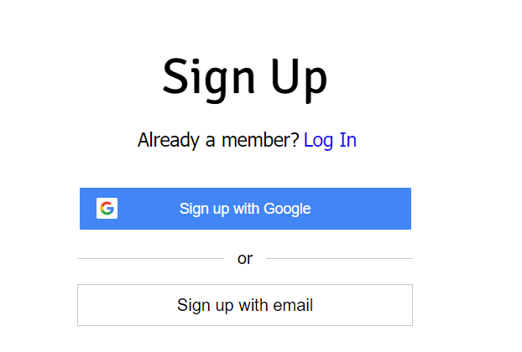

IDP – Identity Provider
An identity provider is a software or group of software which stores all the user credentials and their scopes (roles) in itself. This will centralize the user management in company and simplify the login process to different apps. This way user do not need to remember multiple passwords to multiple apps.
Portal
Launchpad
Dedicated SRM
SSO
SAP Server
GSuite
LDAP
User/email/password
Single source of truth
Trust relation
Scope- clerk, manager, ceo
Outlook
Our cloud app
xsuaa
XSUAA

Slide 6
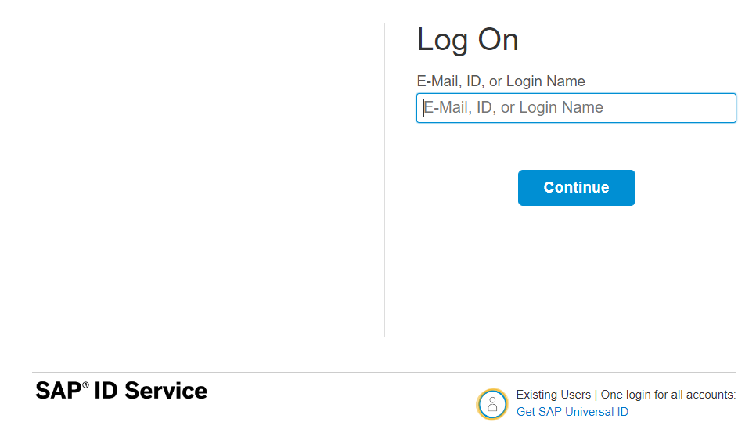
How it works behind scenes
xs-security.json contains information which we need to register to define what are all permissions required in our app
JWT
App
Browser
postman
code
ourxsuaa
trust
JWT
XSUAA
Scope
SAML
trust
IdP

Slide 7

Hands-on Add Security and Test Microservice
Solution:
https://github.com/soyuztechnologies/BTP_Architect_Training/blob/master/Day%203/01mtdbservice.zip

Slide 8
Testing the Microservice from postman
After the deployment, we open the postman tool and try to access resource with URL /vendor url, it gives unauthenticated.
We need to obtain access token so we went to authorization table and added the OAuth2.0 option and provided
Properties | Value
Token Name | BTPJWTToken
Grant Type | Password credentials
Access Token URL | Service key of xsuaa – url, append /oauth/token
Client Id | Service key – client_id
Client Secret | Service key – client_secret
Username | Our BTP account user id
Password | Our BTP account password
3. Call get token and choose use token button once token was fetched.
4. Again make get request for /vendor, and we should get response.
5. If we try /vendor/, it will not work because, we are looking for Role.
6. Went to BTP subaccount and created a Role collection, added the role template and assign same to our user
7. Again get the token and try to access end point for OData, this time it works.

Slide 9
Challenges in Current Approach
Did you notice, that we need to first pass lots of technical details from service key
Pass all the info in correct manner to postman to obtain token
Once the token expired, we need to reobtain again and again
Our end user do not know all this. Automate the XSUAA JWT token processing.
In our app, we will have multiple microservices, like java, sap ui5, node app, xsuaa…
Each service produce one end point e.g. /vendors, /index.html, /customers, they all logically belongs to same app. Will you give 3 url to our user to access these apps?
These microservices also needs to communicate with each other. Provided we give a single end point to access our entire app to end user.
We want to complete redirect mechanism to let user go to login screen, authenticate on IDP and exchange of all the tokens should be seamless behind the scenes.
We need a single entry point for entire app, forwardAuth tokens should be done automatic.
url
Application router
(Provide single entry point, exchange auth token,
Communicate between microservices, like a facade)
xsuaa
Java
/Anubhav.svc
UI5 App
/index.html
Node
/customer

Slide 10
What is Node JS
Node JS is an open source, cross platform, java script runtime environment and used for executing java script code outside the web browser. Java and JavaScript are different by their nature, design and use cases. Java Script was dominantly used as a web programming language. All the browser’s directly understand java script.
Java Script
Java Script
Java
ABAP
Python
C#
Server
request
Client
Browser
port
response
Ryan Dyal
Node JS is also a great web framework for beginners because it works great with data-intensive applications like streaming, real-time apps. It is free and easy to learn node js.
Applications of node js?
Build business logic on server side, DB lookups, Send Emails, write validations, create microservices, add automations, show output, build servers, host web apps, make excel/pdf more…

Slide 11
NPM – Node Package manager
It is a dependency manager tool which gets installed along with node js in our system. Just like for java we had maven, we have npm for node js.
We can find millions of reusable node modules free on internet, which helps us avoid rebuilding everything/reinvent the wheel.
We can see world’s largest reusable code repository on https://npmjs.com
If we want to install any node module
Globally - @computer level, all projects can reuse, option used to install CLI.
npm install -g module
With in the project - @localproject level, only single project can use
npm install module
When we build java project, we saw a pom.xml which contains dependencies. We have the package.json file in node project which contains details about our entire project and its dependencies. To create this we use npm init command.

Slide 12
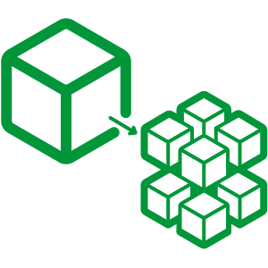

Hands on: Node JS
Solution:
https://github.com/soyuztechnologies/BTP_Architect_Training/blob/master/Day%203/02basicnode.zip
Node Microservice Solution:
https://github.com/soyuztechnologies/BTP_Architect_Training/blob/master/Day%203/03Nodemicroservice.zip

Slide 13
Introduction to App Router
It is a Node JS Application
It is used to automate the process of authentication, authorization with XSUAA to do token exchange
It sits in the middle of IDP and XSUAA, it will redirect the request to our microservice to xsuaa, and eventually to idp
IDP sends the login screen to the user, user authenticates, which is taken to XSUAA, XSUAA issues JWT Token, this JWT token is presented to api end points
App Router takes the JWT token from XSUAA and gives it to our microservices and even exchange this token to multiple microservices inside
It Serves as a single entry point for the entire app.
To tell app router about our multiple microservices so that it can re-direct, we need to create a configuration file named as xs-app.json which contains the details.

Slide 14



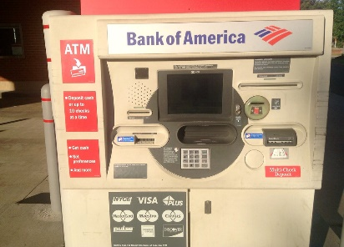
Real World Example
Customer
1
5
4
2
Loan
Credit Card
6
Validate, trust
Deposit
Draft/Cheque
3
FD
*******
7
Locker
This Photo by Unknown Author is licensed under CC BY

Slide 15
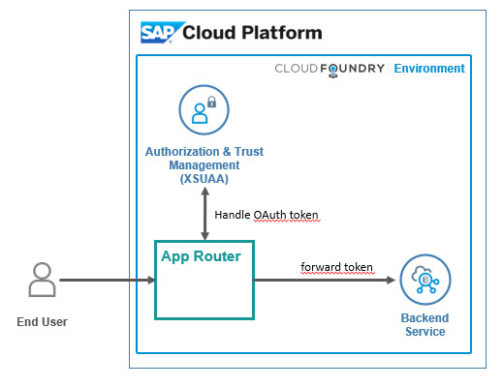
Hands on: App Router
Solution
https://github.com/soyuztechnologies/BTP_Architect_Training/blob/master/Day%203/04approuter.zip

Slide 16
Challenges of building Apps on BTP
Approuter implementation was difficult ➔ lots of effort is required as a developer to setup project
What is the best-practice/ gold-standard to build sap btp applications, recommendation by SAP
Are there any existing sample apps which we can follow to build our app
Many times, as a developer it is hard to add each part of app like files, dependencies, deploy descriptor, lots of code. Can this process be simplified?
How can we have reusability of the code to speed up my development and use sap provided tools to generate the skeleton of the apps
As a developer we want to focus more on functional aspect implementation rather initial project setup
Our apps are sometime tightly coupled with DB technology, develop DB agnostic apps
No matter what is the area we belong FIN, SD, MM, PP, PM, APO, CRM, HR etc. eventually as a developer we all do same work. Design tables, write logic, build UI
How to develop software in BTP, which does not require too much time in handovers
SAP CAPM – Cloud Application Programming Model
It’s a SAP provided framework to develop SaaS apps in BTP which is PaaS. If the developer wants to use open source technologies like Node and Java. Great cost saving and freedom of choice of technology and consultants available easily in market.
SAP RAP – Restful Application Programming Model
It is based on ABAP on Cloud. We can build extensions and SaaS application using this framework. The skill required will be ABAP and CDS knowledge. The deployment is very costly as compared to open-source technologies used in CAP.

Slide 17
Title

Slide 18
Title

Slide 19

What We Did
Let’s Summarize

Slide 20

www.anubhavtrainings.com
Thank You
End of Day 3

Slide 21


We’re committed to empower you to be
#FutureReady
through powerful training solutions.
We build the workforce of the future.
250+
Corporate Clients
30,000+
Learners Trained
25000+
Learners Placed
FREE WEBINARS
Sign up for free webinars with industry experts every fortnight!
Enroll Now!
Contact us today!
https://anubhavtrainings.com

